Slide 1


REDESIGNING THE MILITARY EDUCATION PORTAL
HCI Course Project
Ahmed Tamer Al-Nahhal
Ahmed kareem Biltagy
Saeid Muhammed Elkhouly
Salman Muhammed Mohsen

Slide 2












PROJECT OVERVIEW & HCI PRINCIPLES
OBJECTIVE
Analyze the Military Education Portal, identify HCI violations, and redesign to improve user experience.
USERS
University students (18-25) completing military requirements
HCI PRINCIPLES
Visibility
Feedback
Constraints
Mapping
Make functions apparent
Inform user about actions
Prevent errors by restricting
Control-effect relationship
Consistency
Affordance
Miller 7±2
Norman's Emotional
Similar look & behavior
Suggest how to use
STM capacity limit
Design

Slide 3

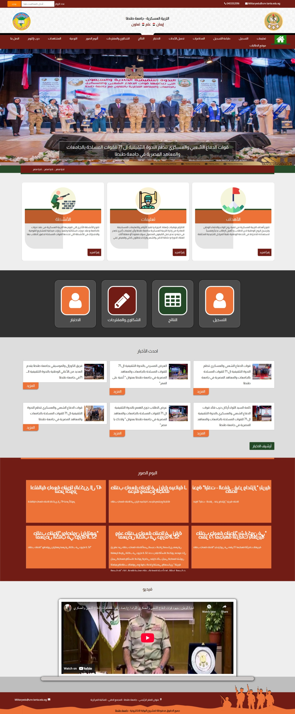





HOMEPAGE - ORIGINAL DESIGN
HCI VIOLATIONS IDENTIFIED
Visibility
14 nav items, buried CTAs, no visual hierarchy
Miller's Law
Exceeds 7±2 limit → cognitive overload
Consistency
Clashing colors (red, brown, green, orange)
Affordance
Service icons look static, not clickable
Visceral Design
Chaotic first impression damages trust

Slide 4
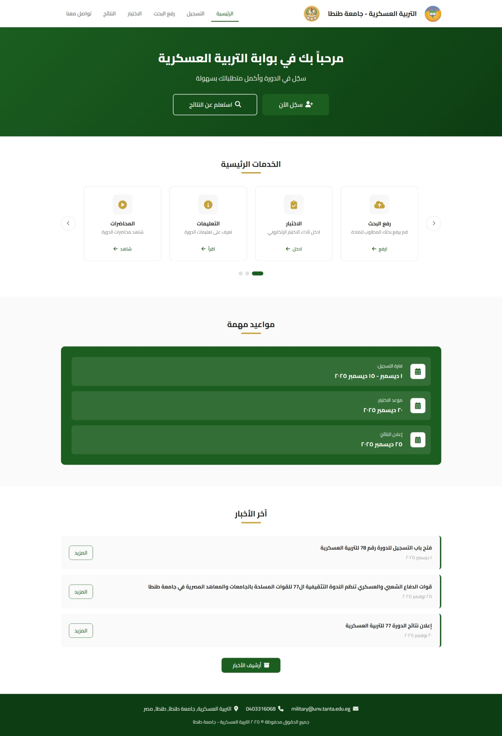


HOMEPAGE - REDESIGNED WITH SOLUTIONS
SOLUTIONS APPLIED
Visibility
Hero section with 2 prominent CTAs
Miller's Law
Reduced nav to 6 items, 4 cards per slide
Consistency
Unified green/gold palette throughout
Affordance
Cards with hover effects & clear action links
Visceral
Clean layout, professional appearance

Slide 5

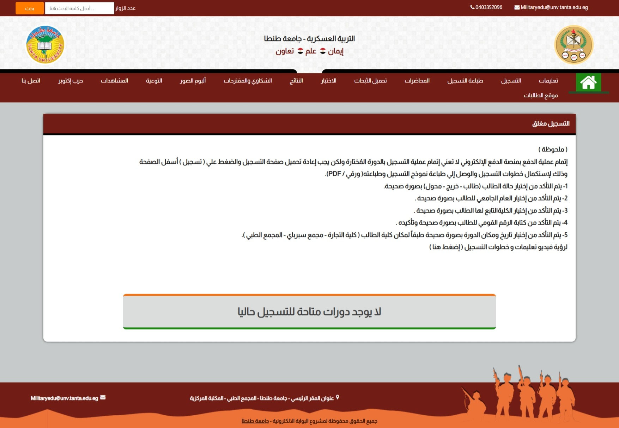

REGISTRATION PAGE - ORIGINAL DESIGN
HCI VIOLATIONS IDENTIFIED
Visibility
Wall of text, buried status message
Feedback
No real-time validation, no loading states
Constraints
Accepts invalid input (letters in ID field)
Mapping
Multi-step process with no progress indicator
Learnability
Must read all instructions before starting

Slide 6
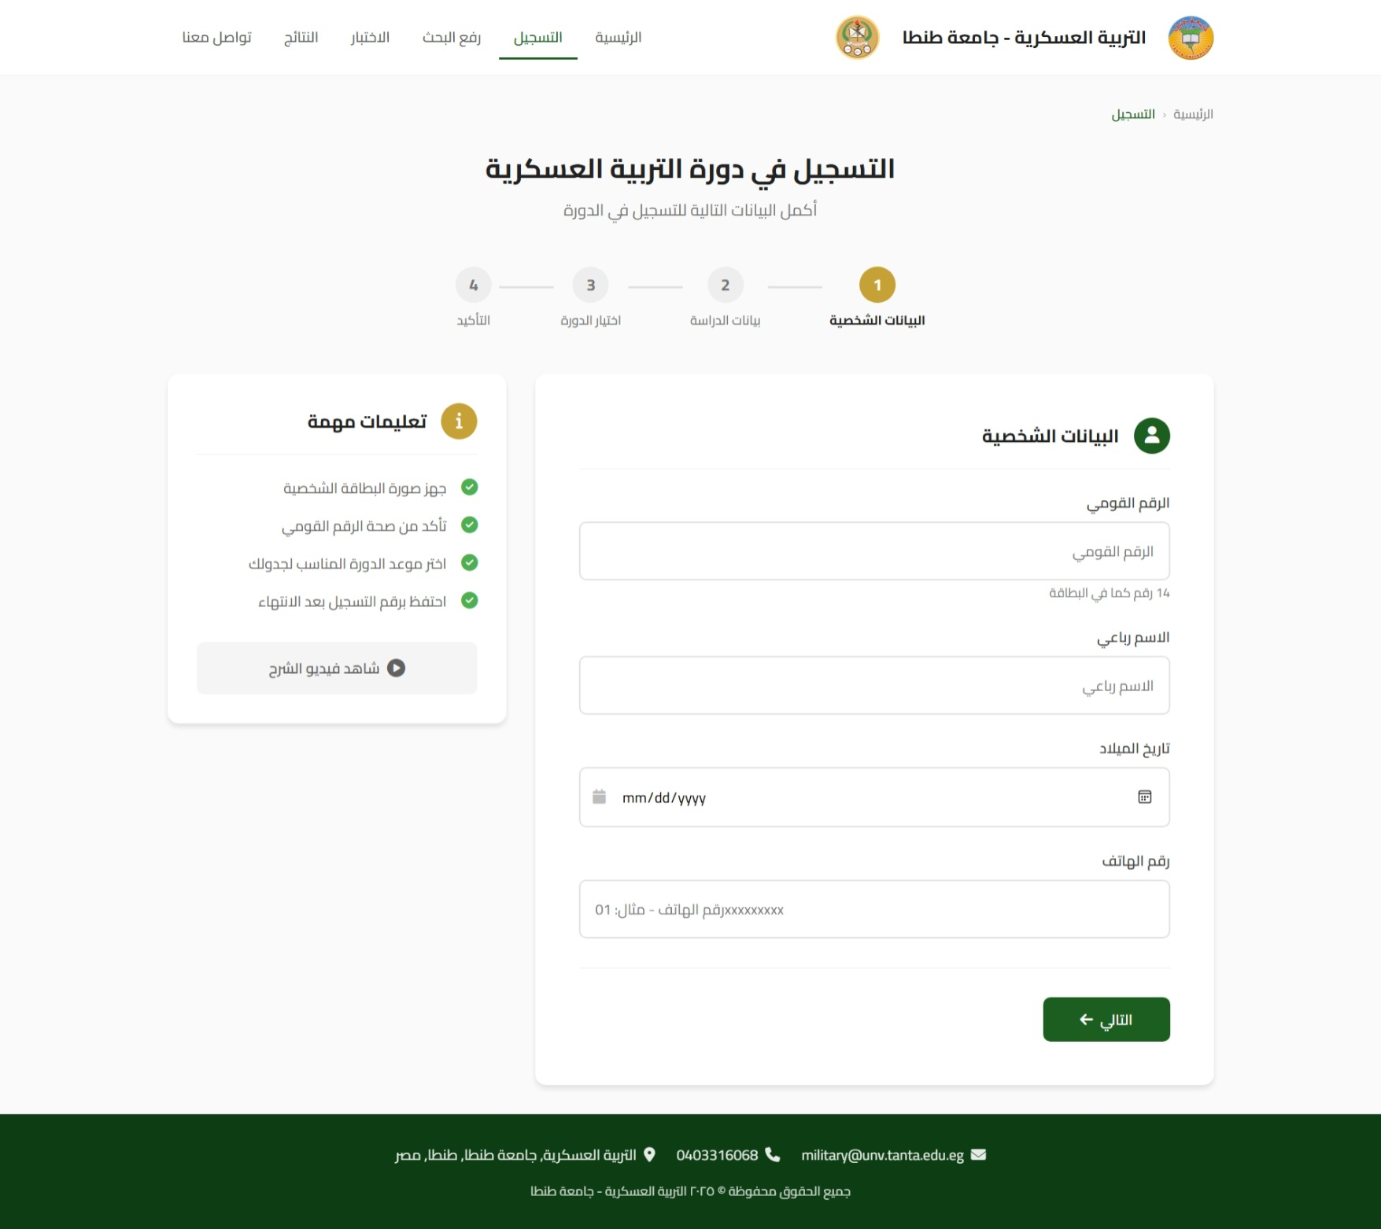
REGISTRATION PAGE - REDESIGNED WITH SOLUTIONS
SOLUTIONS APPLIED
Visibility
Status banner + side panel instructions
Feedback
Real-time ✓/✗ validation + loading spinner
Constraints
Numbers only, disabled btn until valid
Mapping
4-step progress indicator with visual states
1
2
3
4
Learnability
Self-guiding wizard, one step at a time

Slide 7

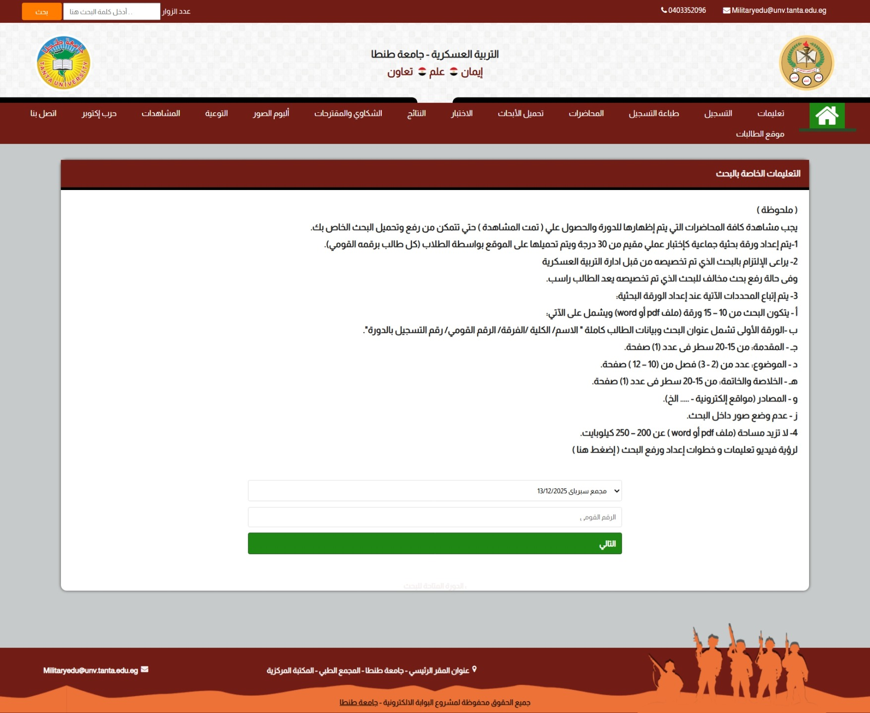
UPLOAD RESEARCH PAGE - ORIGINAL DESIGN
HCI VIOLATIONS IDENTIFIED
Affordance
Plain text field - no drag-drop zone
Mental Model mismatch: users expect drag-drop from Gmail/Drive
Visibility
Requirements buried in dense paragraph
Feedback
No file preview, no upload progress, no success message
Constraints
No immediate validation of file type/size

Slide 8
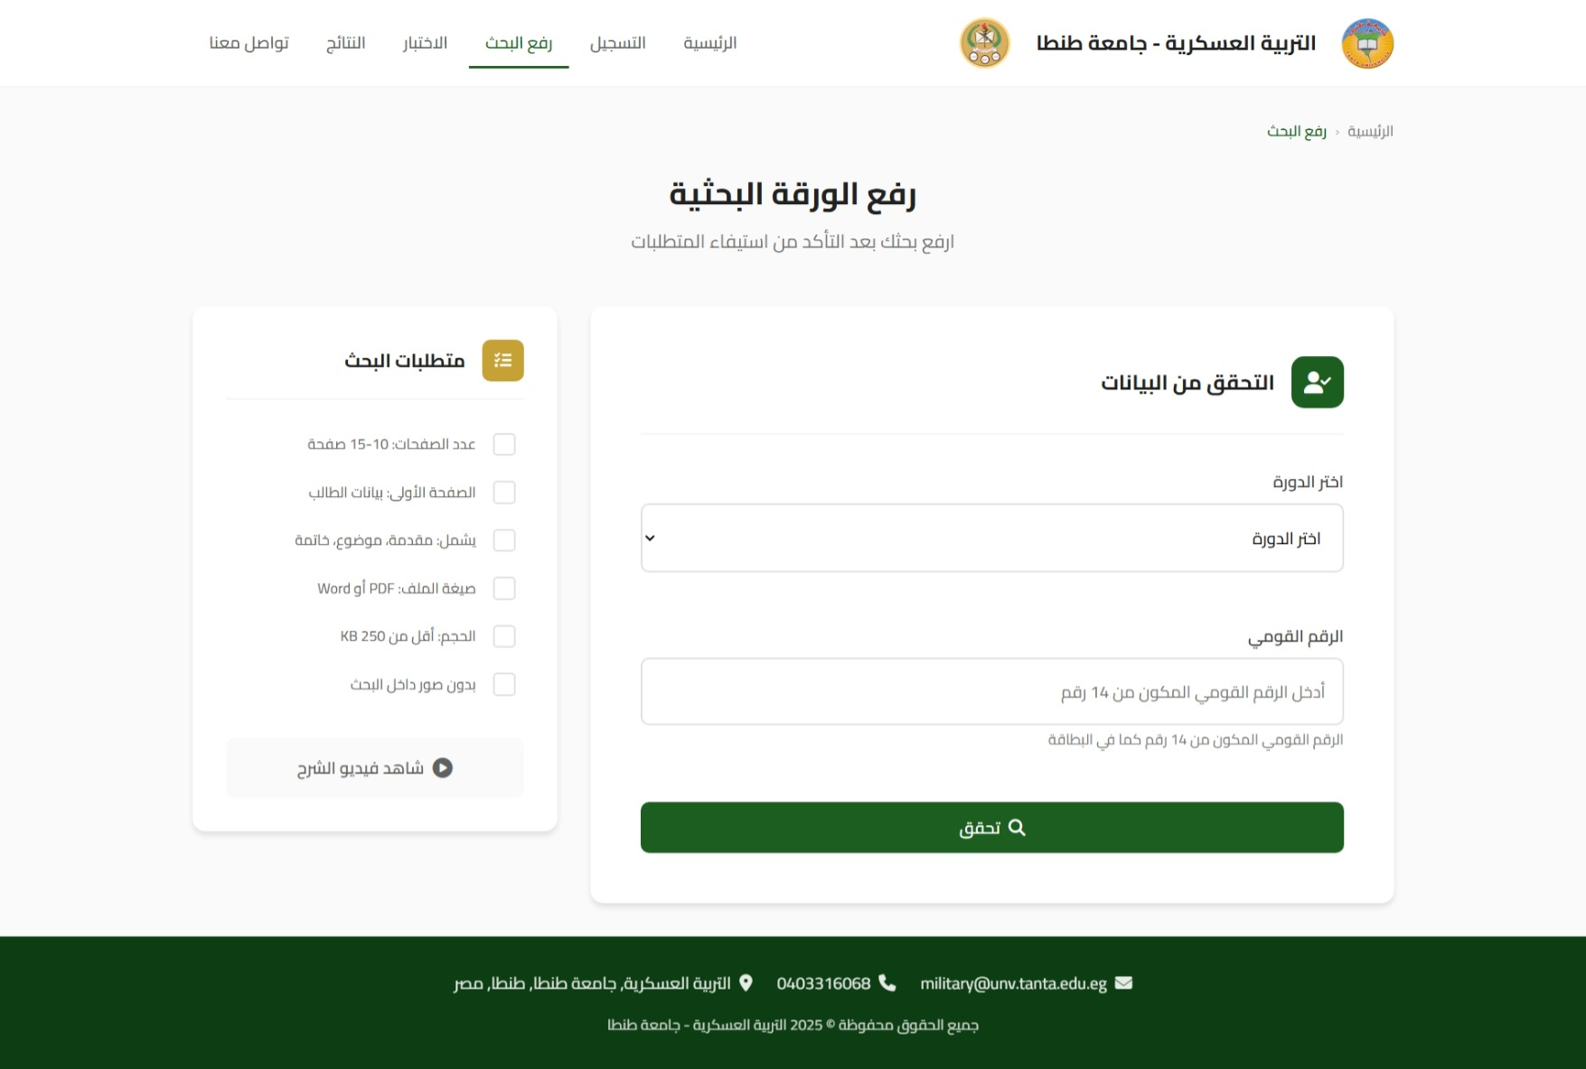


UPLOAD RESEARCH PAGE - REDESIGNED WITH SOLUTIONS
SOLUTIONS APPLIED
Affordance
Drag-drop zone with dashed border + icon
Drop files here
Visibility
Checkbox checklist in side panel
PDF format only
Maximum file size: 5MB
Include all required sections
Feedback
File preview + loading + success screen
Constraints
Instant rejection of wrong type/size

Slide 9

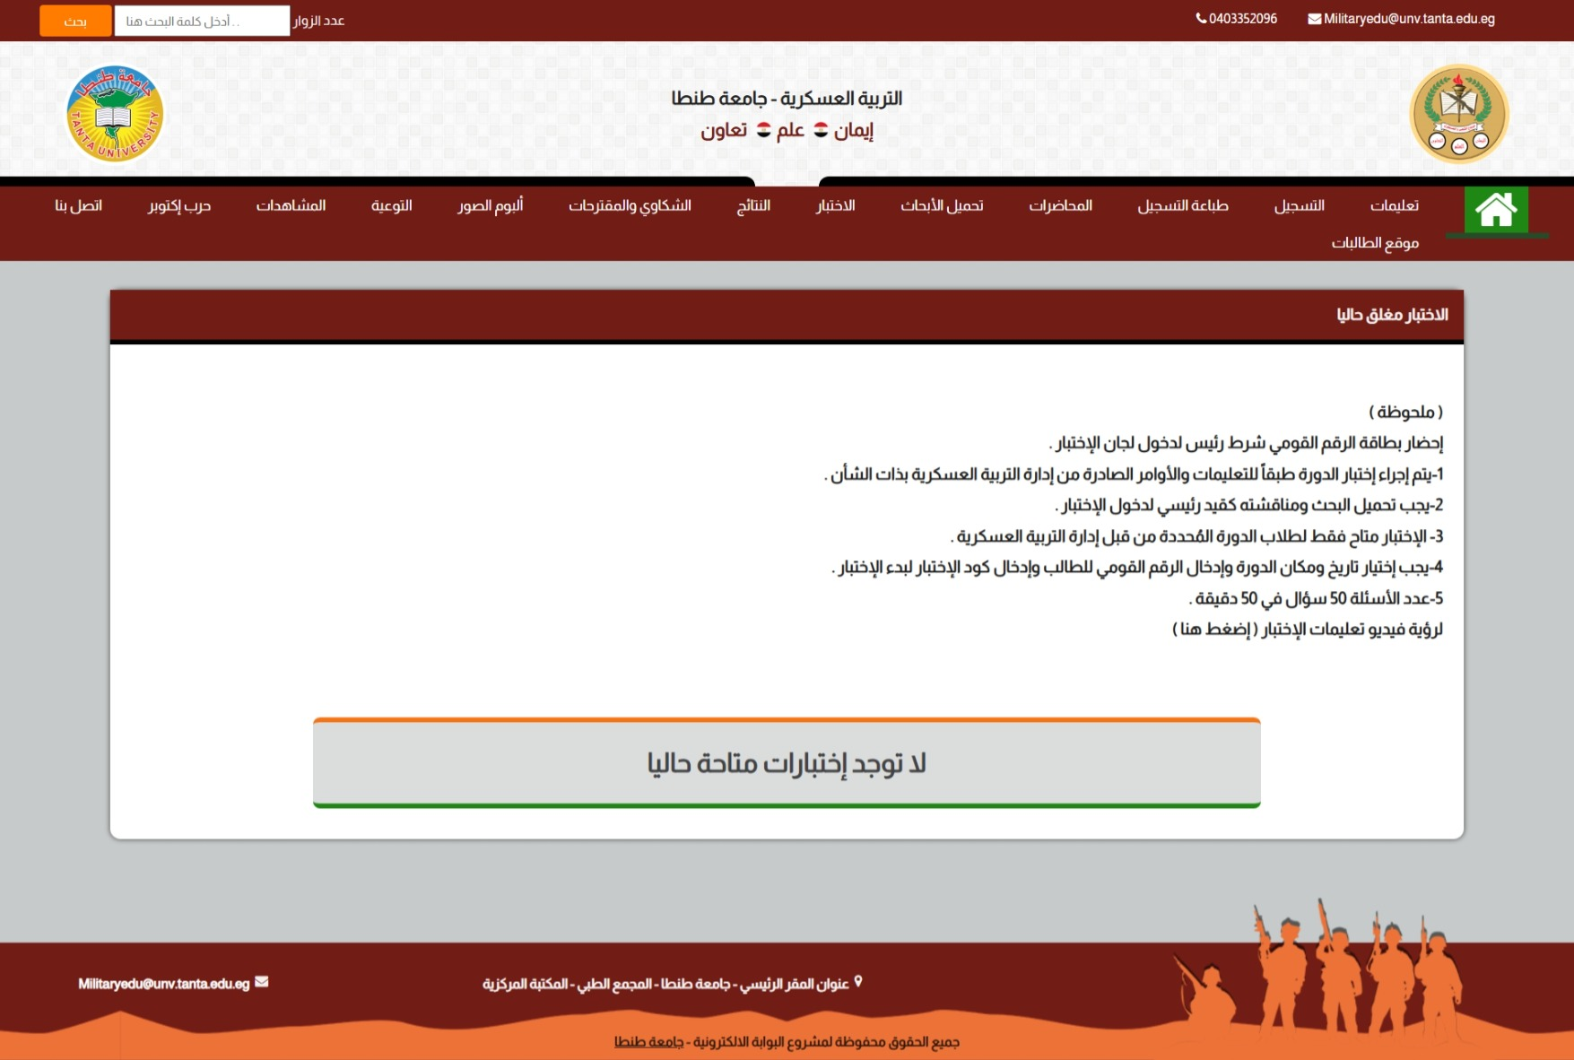

EXAM PAGE - ORIGINAL DESIGN
HCI VIOLATIONS IDENTIFIED
Visibility
Exam info (50 questions, 50 min) buried in text list
Feedback
No validation on inputs, no loading state
Affordance
Plain form, video link is just text
Safety
Pre-exam checklist is plain text - easy to skip
Important warnings not prominent

Slide 10
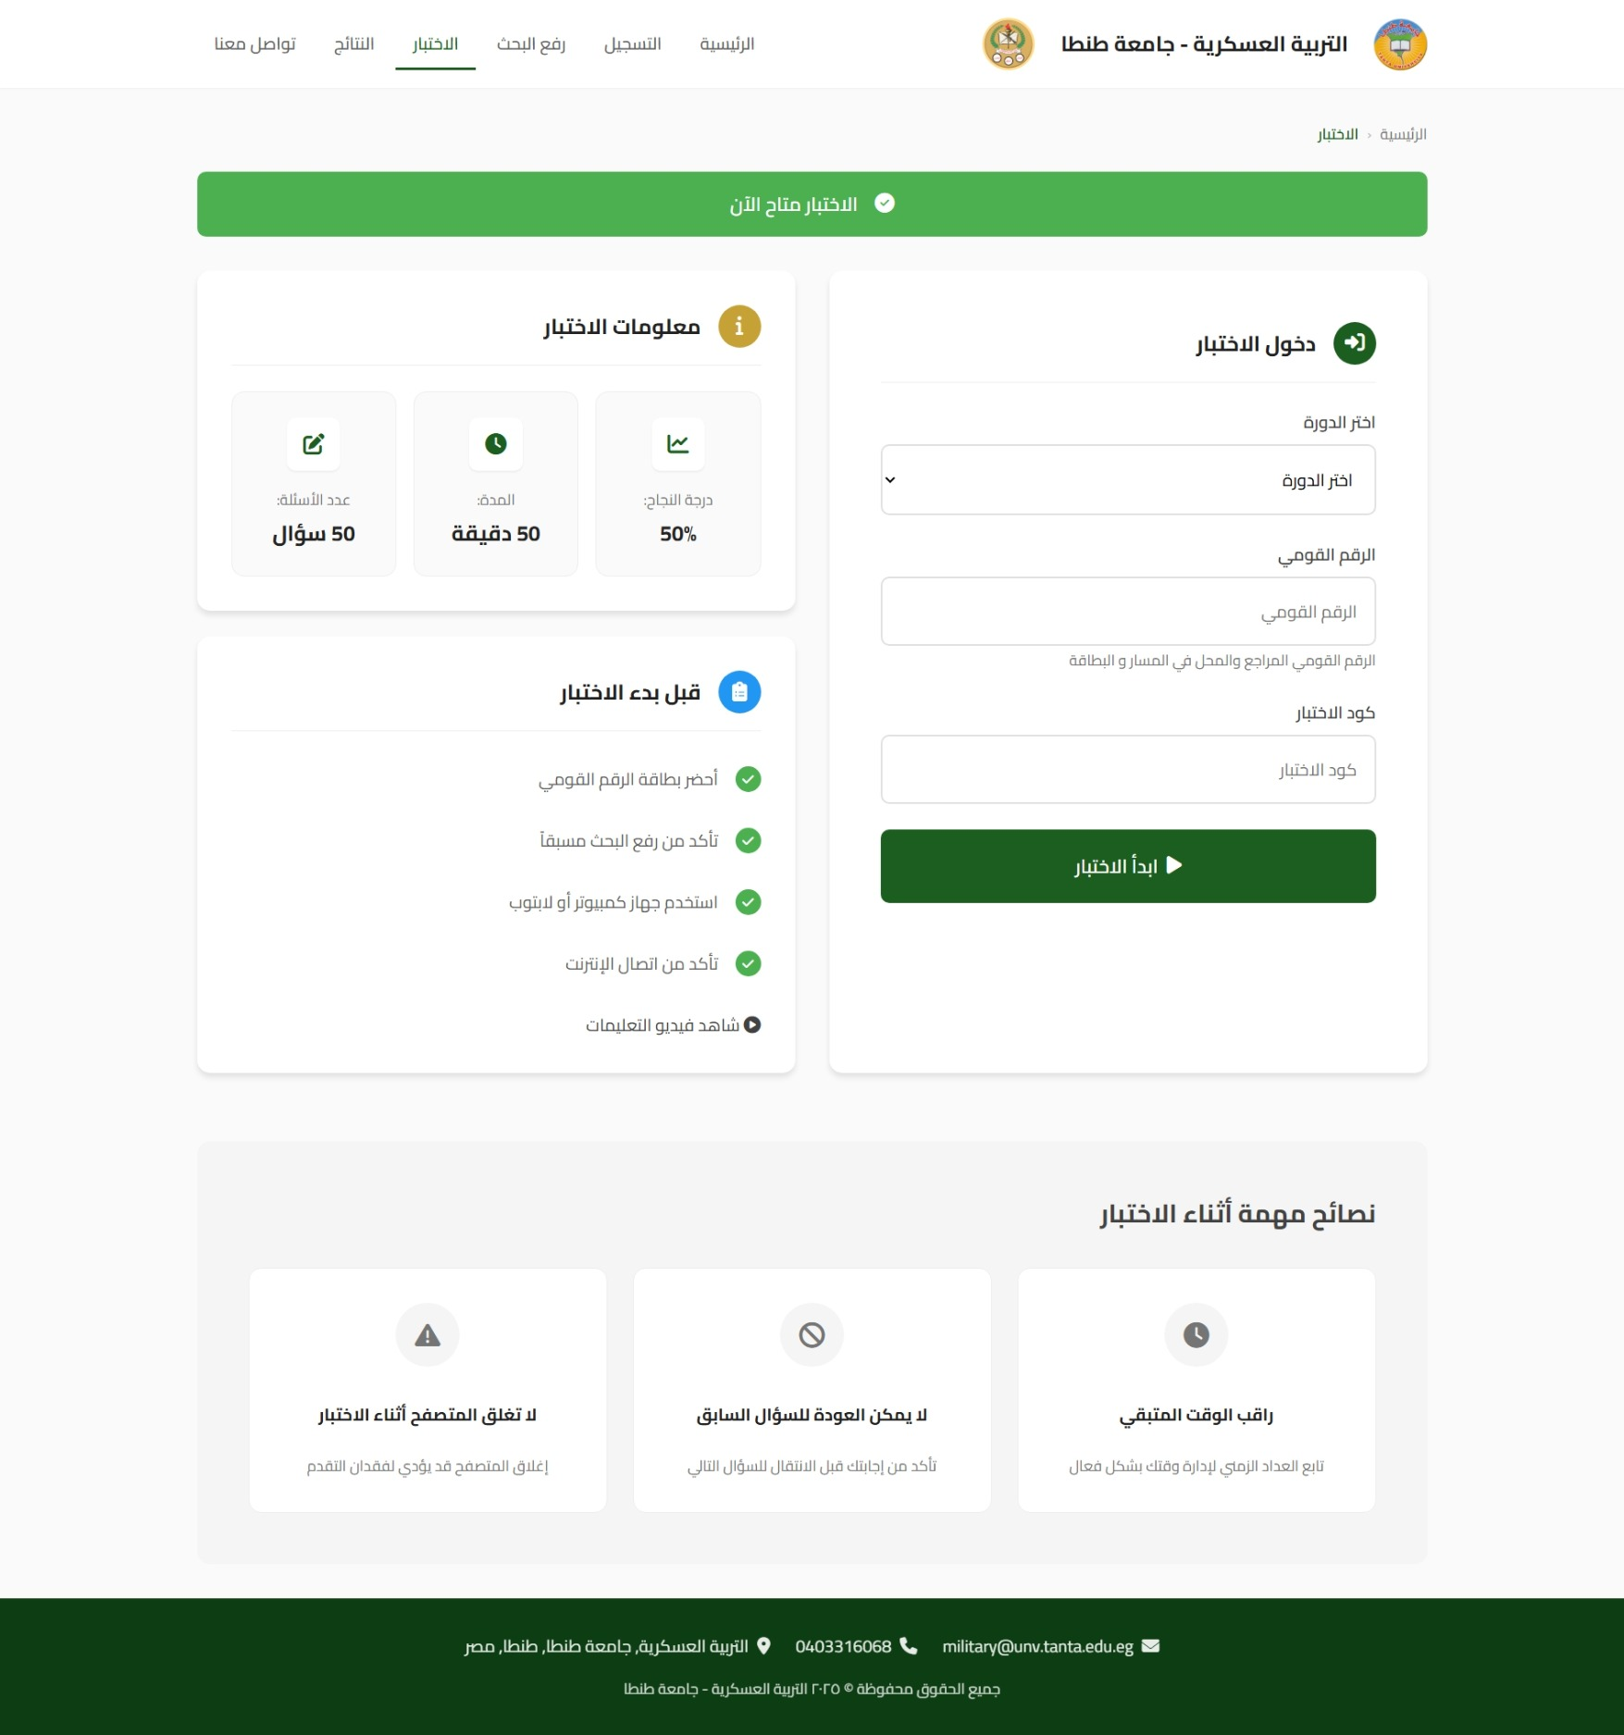

EXAM PAGE - REDESIGNED WITH SOLUTIONS
SOLUTIONS APPLIED
Visibility
Visual stat cards for exam info
Feedback
Real-time validation + loading states
Affordance
Card-based form, clear "Start Exam" button
Safety
Pre-exam checklist with ✓ icons
Stable internet connection
Quiet environment
Warning tip cards for important rules

Slide 11

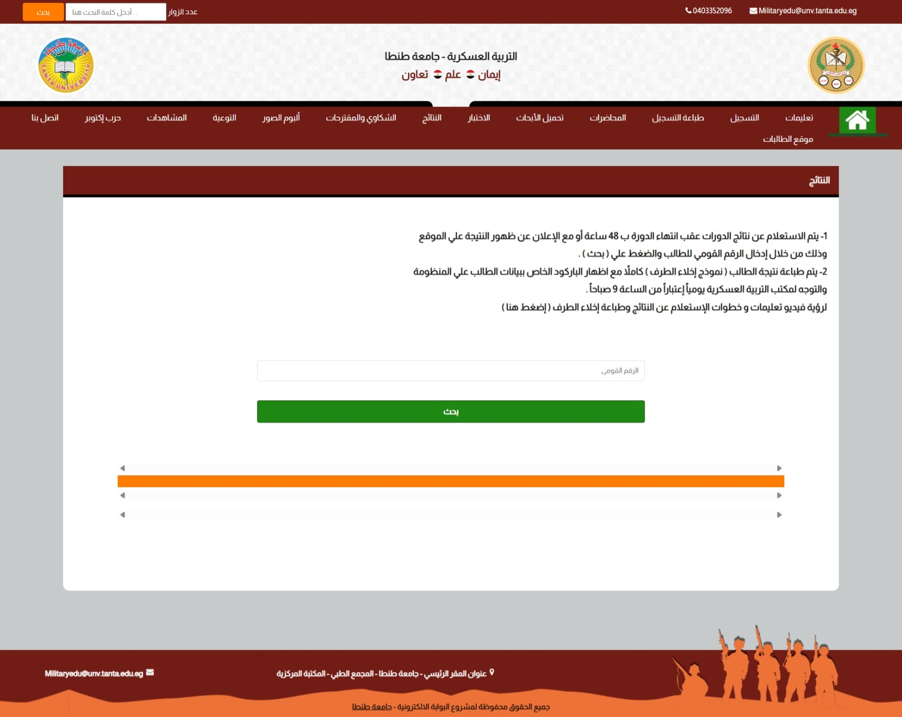
RESULTS PAGE - ORIGINAL DESIGN
HCI VIOLATIONS IDENTIFIED
Feedback
No validation while typing
Meaningless progress bars, no loading state
Unclear result display
Visibility
Instructions as wall of text above form
Affordance
Plain input field, unclear button
Constraints
Accepts letters in National ID field
Consistency
Different style from other pages

Slide 12
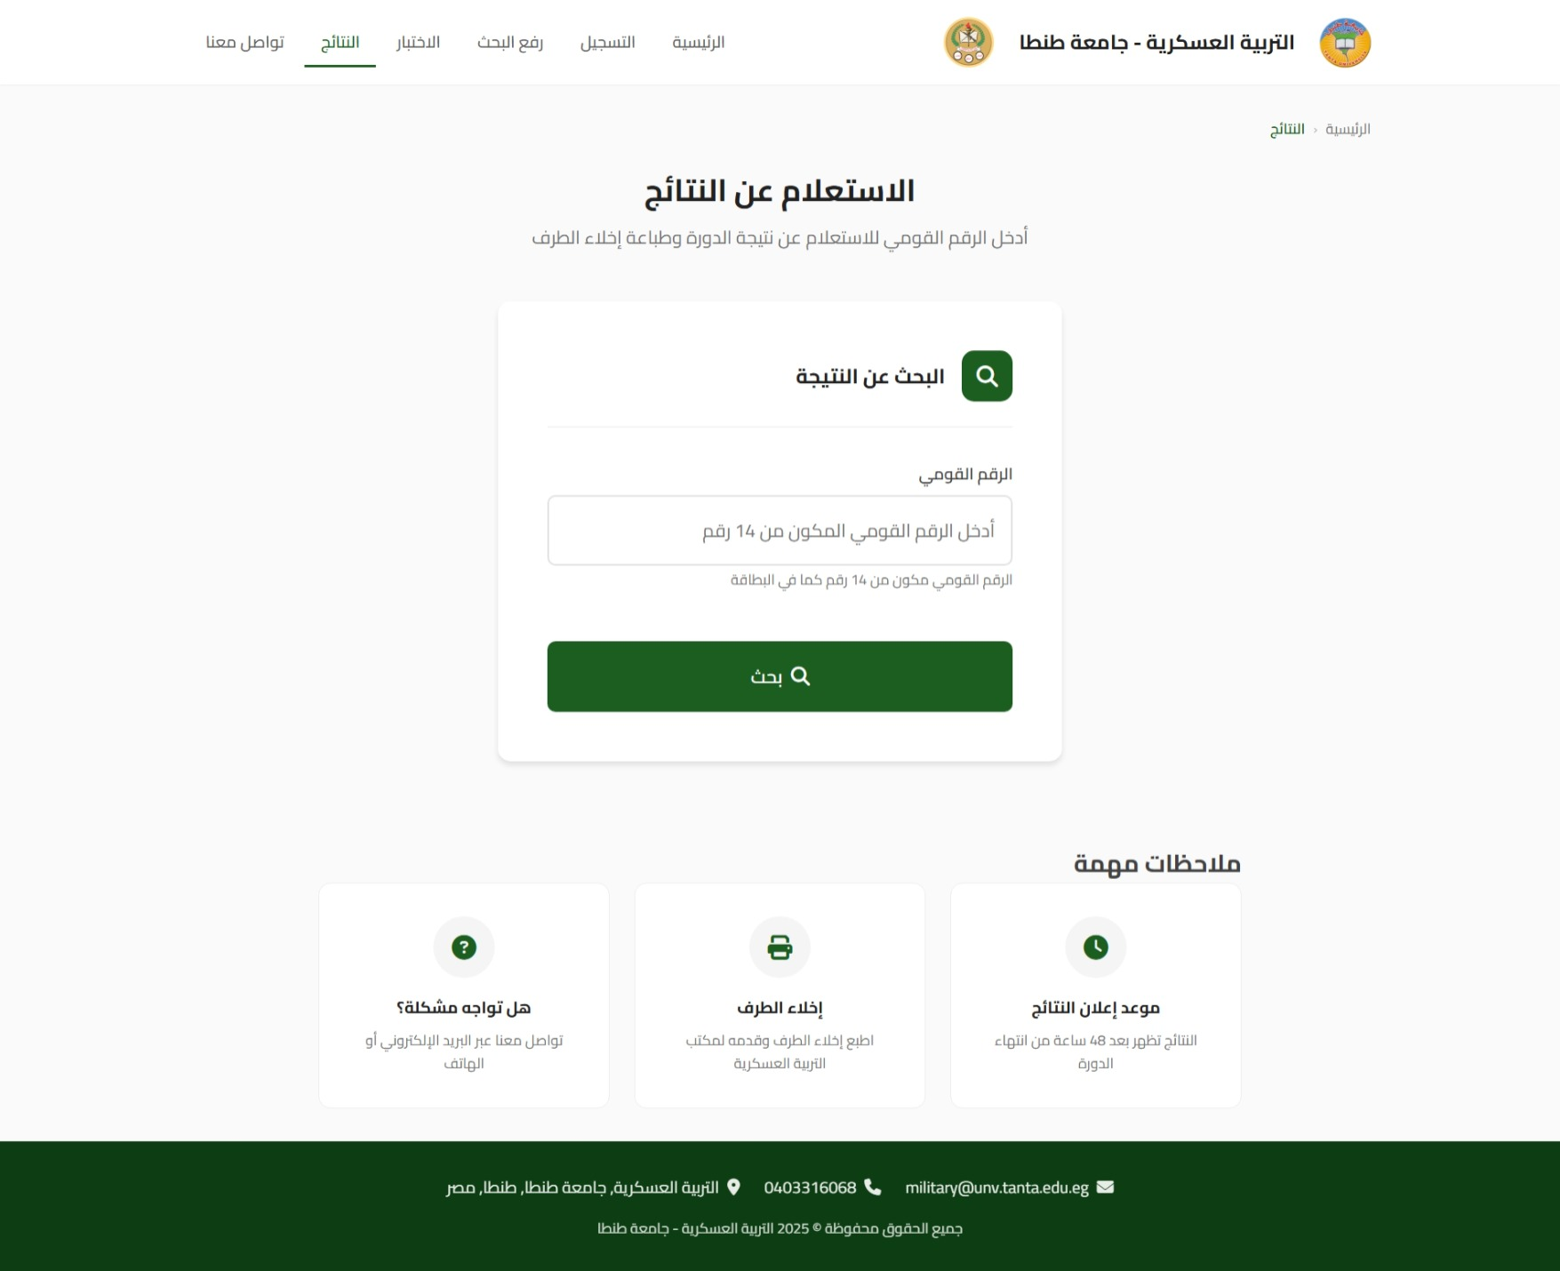


RESULTS PAGE - REDESIGNED WITH SOLUTIONS
SOLUTIONS APPLIED
Feedback
Real-time ✓/✗ as user types
Valid input
Invalid input
Loading: "جاري البحث..." with spinner
Clear result cards (green=pass, red=fail)
Visibility
Clean centered form, notes as tip cards below
Affordance
Large prominent search button
Constraints
Numbers only, max 14 digits enforced
Consistency
Same design system as all other pages

Slide 13









ALL PAGES - BEFORE & AFTER OVERVIEW
PAGE
KEY VIOLATIONS
KEY SOLUTIONS
14+ nav items
6 nav items
Homepage
Clashing colors
Green/gold palette
No visual hierarchy
Hero + card slider
No progress indicator
4-step wizard
Register
No validation
Real-time ✓/✗
Wall of text
Side panel help
Plain text field
Drag-drop zone
Upload
No file preview
Preview + success screen
Dense requirements
Checkbox checklist
Meaningless bars
Clear result cards
Results
No validation
Real-time ✓/✗
Inconsistent style
Unified design
Exam
Info buried in text
Visual stat cards
Plain warnings
Checklist + tip cards

Slide 14









USABILITY GOALS ACHIEVEMENT
Effectiveness
Clear paths to complete all tasks
Step-by-step wizards guide users
Reduced navigation (14 → 6)
Efficiency
Prominent CTAs, fewer clicks
Safety
Input constraints prevent errors
Confirmation dialogs for important actions
Learnability
Self-explanatory interface
Familiar patterns (drag-drop, wizards)
Memorability
Consistent design across all pages
Recognition over recall (dropdowns, icons)
Utility
All required functions accessible
Extra features: Print receipt, Download PDF

Slide 15




NORMAN'S EMOTIONAL DESIGN APPLIED
VISCERAL (First Impression)
BEFORE
AFTER
Chaotic, cluttered → Anxiety, distrust
Clean, professional → Confidence, trust
BEHAVIORAL (Usability)
BEFORE
AFTER
Confusing, no feedback → Frustration
Intuitive, guided → Satisfaction
REFLECTIVE (Identity)
BEFORE
AFTER
Outdated → Embarrassment
Modern → Pride in institution

Slide 16



MEMORY & COGNITIVE PRINCIPLES APPLIED
MILLER'S LAW (7±2)
Navigation: 14+ → 6 items
Services: 4 cards per slider view
Registration: Chunked into 4 steps
RECOGNITION OVER RECALL
Dropdown menus (select, don't type)
Visual icons with text labels
Course selection as visual cards
MENTAL MODEL ALIGNMENT
Drag-drop matches Gmail/Drive experience
Step wizard matches e-commerce checkout
Universal icons: ✓ = success, ✗ = error

Slide 17















DESIGN SYSTEM & CONSISTENCY
UNIFIED COLOR PALETTE
TYPOGRAPHY
Primary: Green #1B5E20 (Trust, Institution)
Cairo font family - optimized for Arabic
Accent: Gold #C6A135 (Military, Prestige)
Consistent size scale and weight hierarchy
Success: Green
Optimized line height for readability
Error: Red
REUSABLE COMPONENTS
RESPONSIVE DESIGN
Buttons
Cards
Works on desktop, tablet, and mobile
Forms
Header/Footer
Desktop
Tablet
Mobile

Slide 18




LIVE DEMO
DEMONSTRATION
Homepage
Results
Navigation & services slider
Search with test IDs:
00000000000000 → Pass (ناجح)
44444444444444 → Fail (راسب)
Registration
Any other → Not found
Step wizard & validation
Exam
Upload
Stat cards & checklist
Drag-and-drop & file preview

Slide 19

CONCLUSION & KEY TAKEAWAYS
1
HCI principles are PRACTICAL TOOLS, not just theory → Every principle directly improved our design
2
COGNITIVE LIMITATIONS must guide design decisions → Miller's Law shaped our navigation and chunking
3
SMALL CHANGES make big differences → Adding ✓/✗ icons dramatically improves feedback
4
CONSISTENCY reduces learning curve and builds trust → One design system = learn once, use everywhere
5
Match CONCEPTUAL MODEL to user's MENTAL MODEL → Drag-drop matches what users expect from modern apps
🎯 Our redesign transforms frustration into intuitive experience

Slide 20


THANK YOU!
Ahmed Tamer Al-Nahhal
Ahmed kareem Biltagy
Saeid Muhammed Elkhouly
Salman Muhammed Mohsen
HCI Course - December 2025

